Slide 1
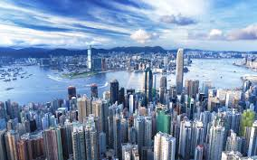
Urbanisation
Year 8 Geography

Slide 2
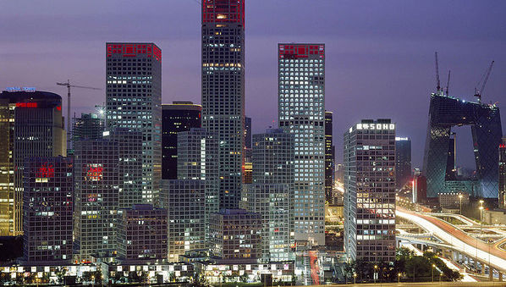
Consider
What is urbanisation?
What causes urbanisation?
Why do people choose to move from rural areas to urban centres?
List six examples of Infrastructure

Slide 3
Urbanisation
Urbanisation is the movement of people from rural areas to large cities. Cities are becoming increasingly densely populated.
This occurs rapidly in developing countries.
Infrastructure Challenges:
Housing
Employment
Clean water
Electricity
Sewerage systems

Slide 4

Glossary: write these definitions into your notes
Urban Growth – the increase in the population living in cities, expressed as a number measured over a period of time
Urbanisation – the process by which an increasing proportion of a population lives in towns and cities measured as %
Push and Pull Factors – Push: reasons why people leave rural areas. Pull: reasons why people move to cities.
Mega City – a city with more than 10 million people
World City – a city considered to be an important centre of global economic activity, such as New York, Tokyo, London and Paris
Infrastructure - The basic physical and organizational structures and facilities (e.g. buildings, roads, power supplies) needed for the operation of a society.

Slide 5

Vocabulary
Biodiversity:
This is the variety of all living things.
Plants
Animals
Micro organisms
Ecosystems
Biodiversity creates the complexity of life on Earth.

Slide 6

Urbanisation
https://www.youtube.com/watch?v=mPi4zwEpswE
An Urbanising Planet
Read by Edward Norton
(Do you know what movies he has been in?)
(3.21 minutes)
Watch twice. Answer the question sheet provided.

Slide 7
Urbanisation
https://www.youtube.com/watch?v=_jnMivEZ8gc
Megacities of 2050
Listen for and note down interesting facts about:
Shenzhen
Karachi
South Korea
Mexico
What will life be like in megacities of the future? (5 dot points)

Slide 8

Rate of Urbanisation

Slide 9
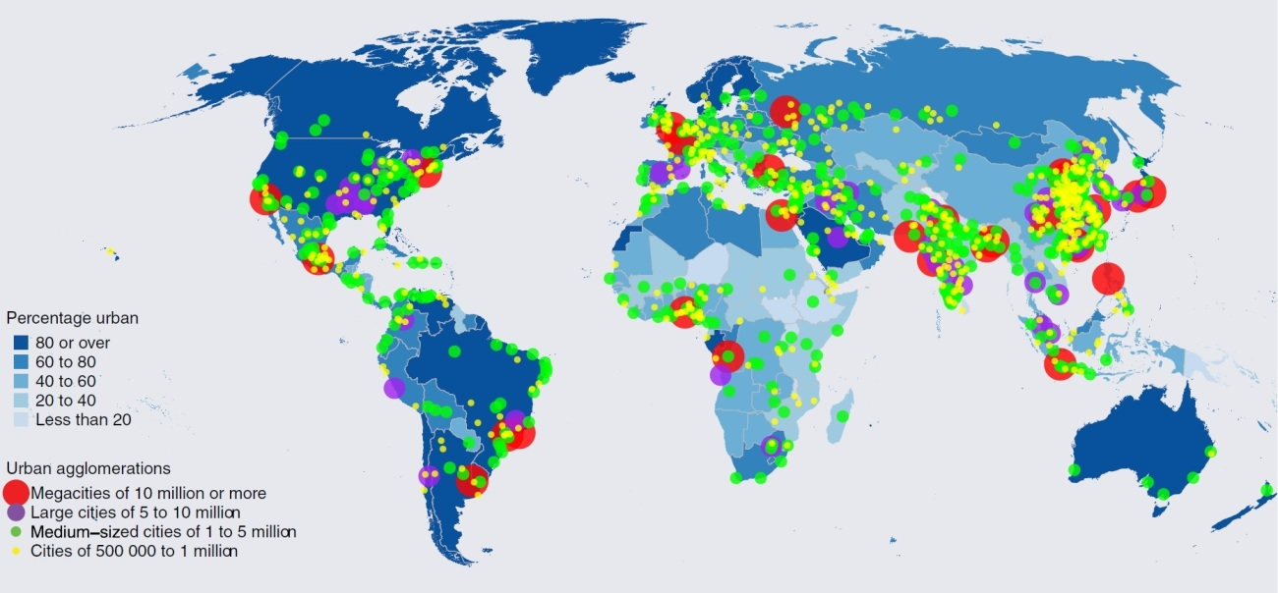
Percentage of people living in Urban areas

Slide 10
Why move to cities? Pull Factors
Employment opportunities
“Promise” of higher standards of living
Entertainment
Medical Facilities
Educational Opportunities

Slide 11
Why move from rural areas?
Push Factors
Landlessness
War
Desertification
Rapid population growth
Rural poverty
Lack of educational opportunity
Move from subsistence farming to commercial farming
Intolerance to alternative lifestyles

